Slide 1
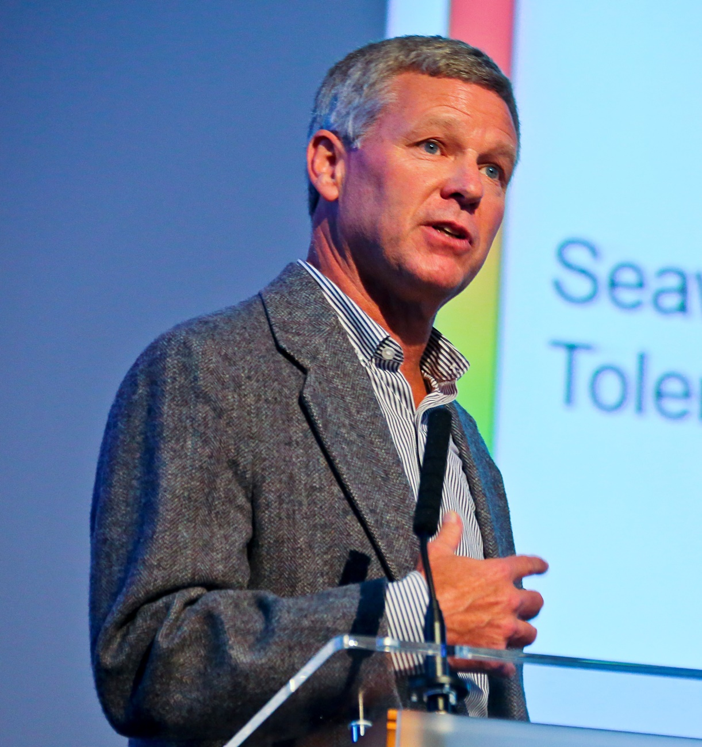
VI Ciclo CEIMAR
Conferencias de Excelencia
“Physiology and endocrinology of smolt development in salmon”
“Thermal physiology of fishes”
Prof. Dr. Steve McCormick
Jueves 22 noviembre 2018
De 11:30 a 13:30
Salón de Grados del CASEM
Stephen D. McCormick, is Leader of the Physiology Section at the Conte Anadromous Research Center Laboratory (USGS) in Turners Falls, MA and adjunct professor at the University of Massachusetts.
His research team focuses on the environmental physiology of migratory fish and how this knowledge can be used to enhance, conserve or restore anadromous fish populations. This research has centered on the environmental and hormonal control of water and salt balance, development, growth and reproduction of anadromous fishes, including salmon, trout, shad, alewife, sturgeon and lamprey. This research has addressed important environmental issues including acidification, impacts of dams, endocrine disruptors and climate change, especially the impacts of temperature and salinity.
The results of this work have been published in more than 170 papers and book chapters.

